Slide 1
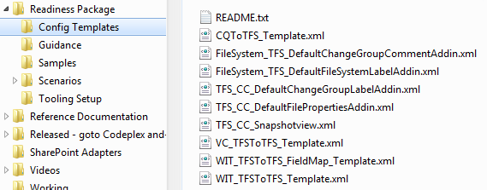
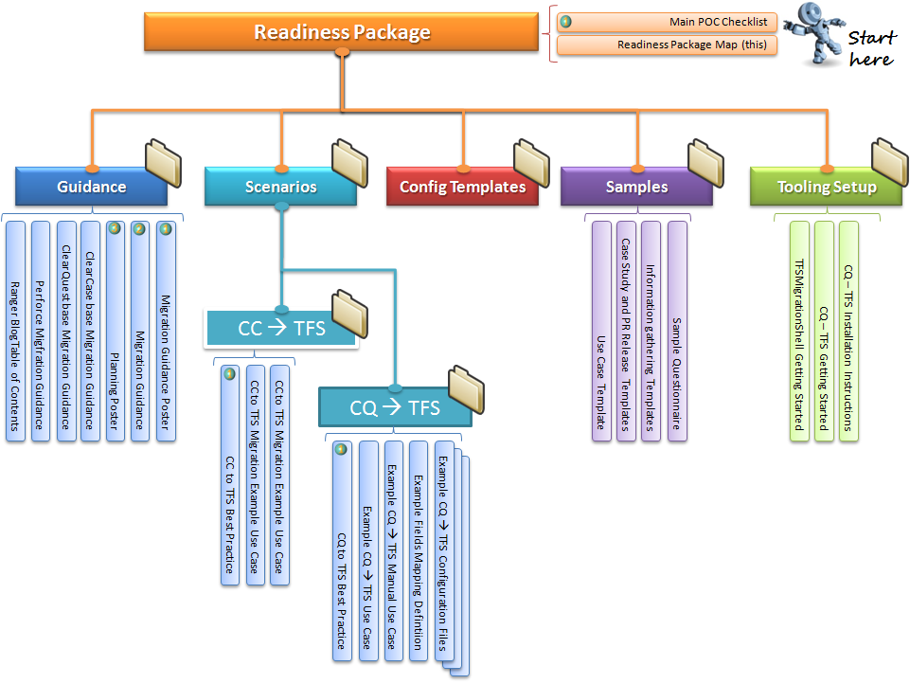
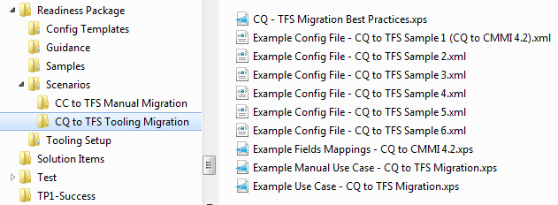
1
2

Slide 3
1
Link 1
1
Link 1
Link 3
4
Link 6
3
2
4
2
Link 4
Link 5
Link 2
3
Link 2
3

Slide 4
Conchango Scrum
Process Template
WI#1
WI#2
Scrum.ImplementedBy
Link Type

Slide 5
MSF Agile
Process Template
WI#1
WI#2
Microsoft.TeamFoundation.Migration.TFS.LinkType.WorkItemToWorkItem
Link Type

Slide 6
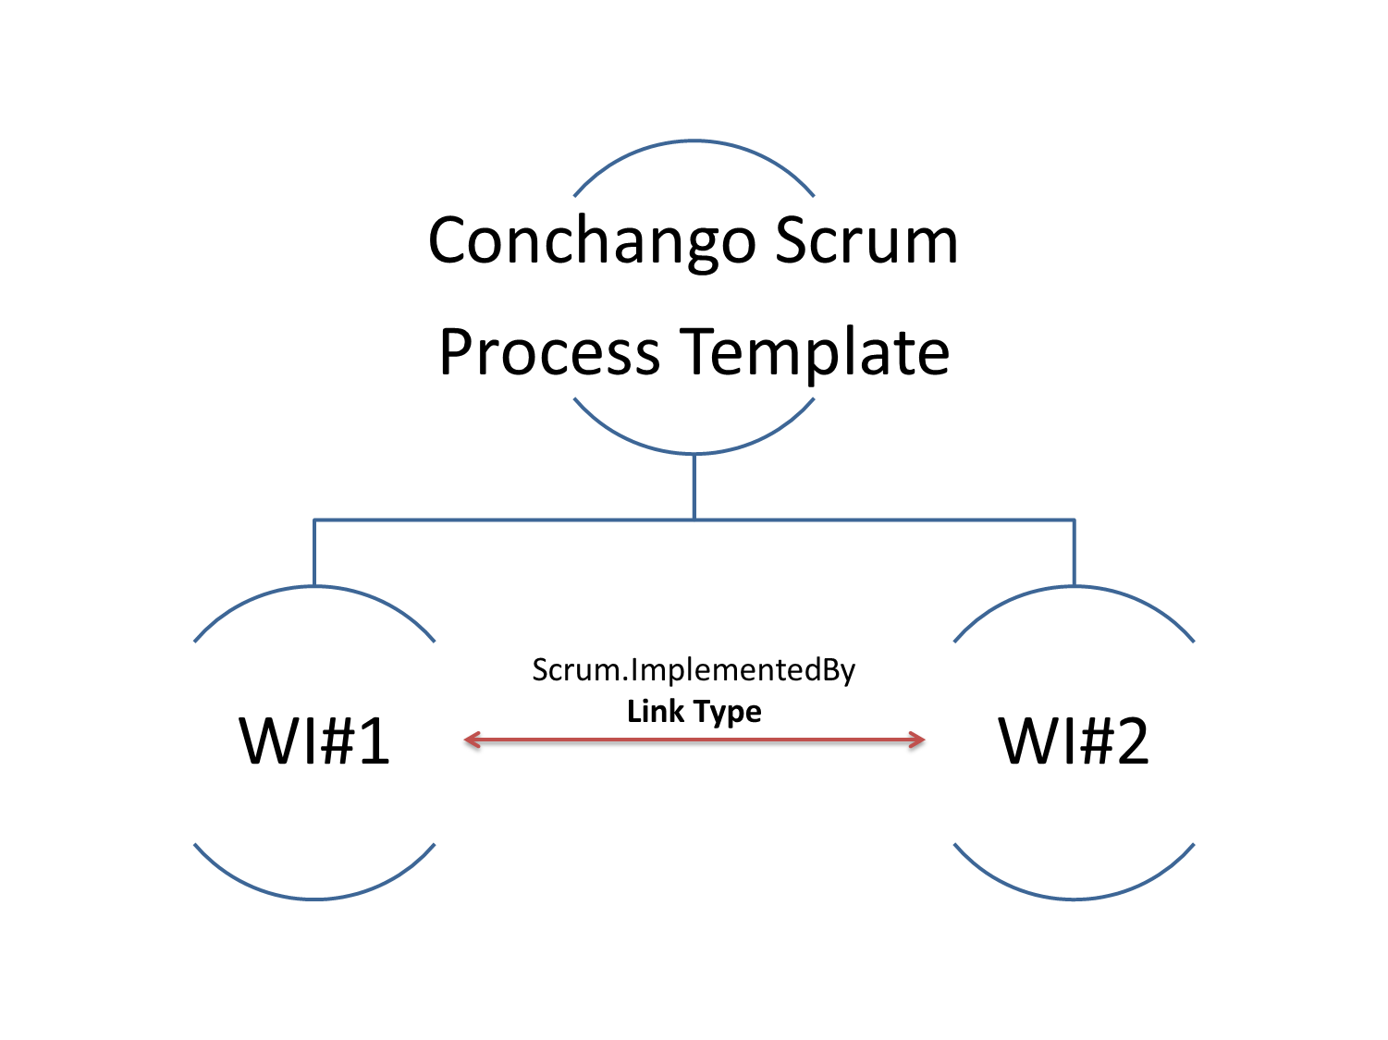
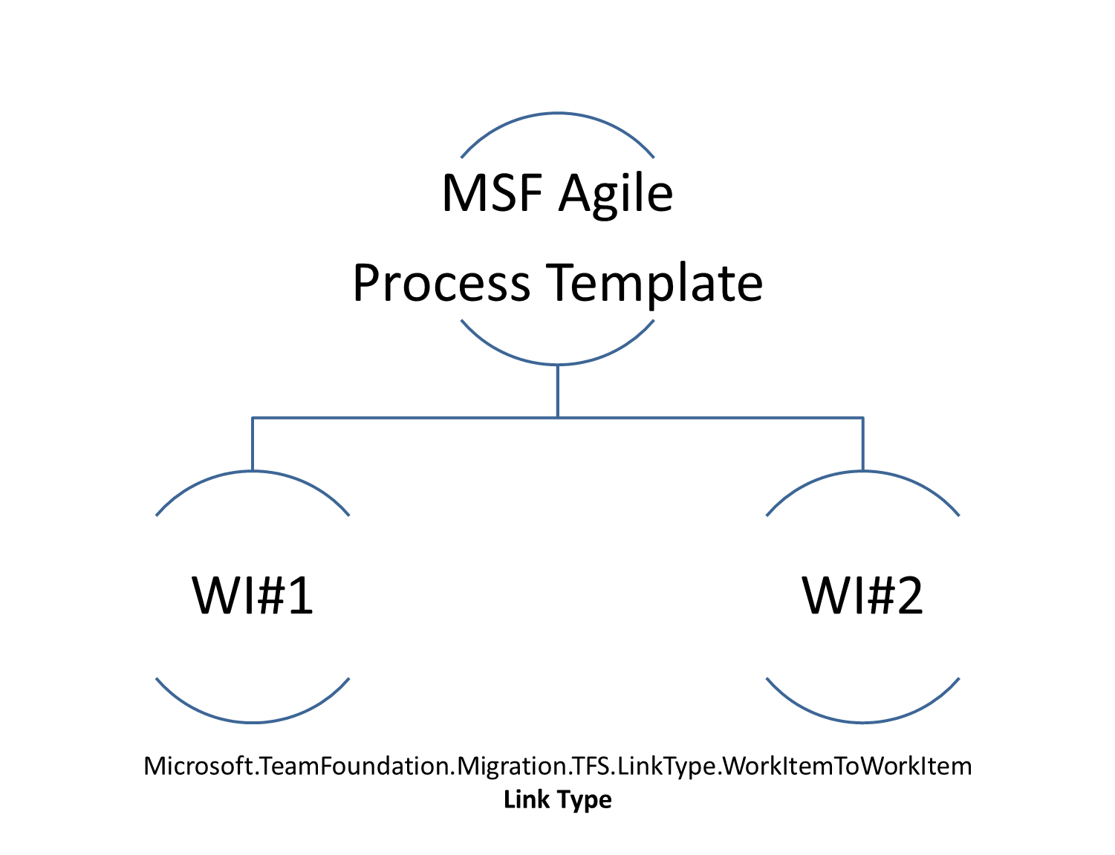
?

Slide 7
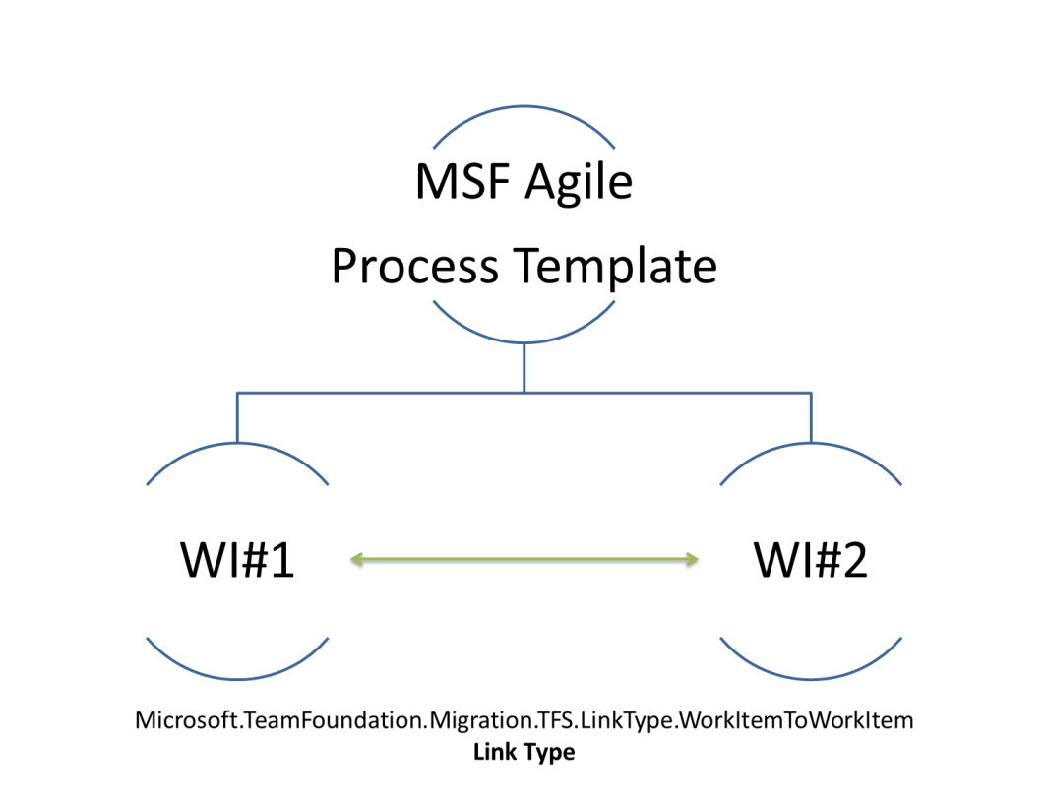

Slide 8






Scenario 1
Same users on source & target
userA
userA
userB
userB
userC
userC

Slide 9
Scenario 2
Different users on source & target
userA
userA
userB
userB
userC
userD

Slide 10
Scenario 3
Hybrid scenario 1 & 2
userA
userA
userB
userB
userC
userD
userD
userE
No user
userE

Slide 11
Resolve Conflict using Rule and “Resume” Migration
Migration
Conflict
Conflict Resolution Rule
Manual merge at Source
Manual Merge at Target
X
Y
A
B
Z
C
Target Changeset = C
Target Changeset = Z
Manual Intervention

Slide 12

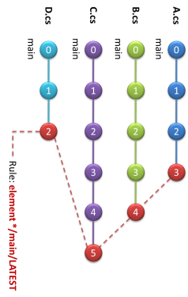
Config Spec
ClearCase
Team Foundation Server
2
5
3
6
1
C:\DropZone
$:/TeamProject
4

